Slide 1
Project-4 Feature Extraction & Price Prediction For Mobile Phones NextHikes Solutions By - Rakshit A Solanki

Slide 2
Project Overview
Mobile Price Analysis
This project focuses on analyzing a mobile dataset to understand how technical features influence mobile pricing.
It helps in identifying meaningful trends and hidden patterns within the dataset using proper analysis techniques.
The study provides a clear understanding of how pricing varies across different mobile devices and configuration.
Data Understanding
The dataset includes attributes such as RAM, Memory, Battery capacity, Processor and price for detailed analysis.
It represents mobile data collected from different categories and configuration.
It provides a strong base for both exploratory data analysis and advanced data techniques.

Slide 3
Project Objective
Price Distribution Analysis
The project aims to analyze how mobile prices are distributed across different categories like Budget, Mid-range and Premium segments.
It helps in identifying how products are concentrated within specific price range.
It also highlights demand patterns in different pricing segments.
Feature Impact Analysis
The project focuses on identifying how features like RAM, Memory and Battery affect mobile pricing.
It explains the role of technical specification in determining product value.
The analysis helps identify which features contribute most to price range.

Slide 4
Dataset Information
Dataset Structure
The dataset contains around 541 mobile records with multiple technical features.
It provides a clear overview of different mobile configuration.
It includes both numerical and categorical variables.
Important Variables
The dataset includes variables like RAM, Processor and Price.
These variables are important for understanding performance and pricing.
Each variable contributes to evaluating product value.
Price is considered as the main variable in this analysis.
It represents the final outcome influenced by other features.

Slide 5
Data Cleaning Process
The dataset was cleaned by removing the unnecessary column as it had no relevance to the analysis.
Column names were standardized by removing extra spaces, symbols and inconsistencies to improve readability.
Duplicate records were identified and removed to ensure accuracy and avoid repetition in the dataset.
Missing Values were checked across all columns to ensure completeness of the dataset.
Data types were verified and corrected whenever required to avoid errors during analysis.
These processes improved the overall quality, reliability and usability of the dataset for further analysis.

Slide 6
Outlier Detection
Outliers were identified using the Interquartile Range (IQR) method to detect extreme values present in the dataset.
Approximately 25 outliers were detected in the price variable which lie outside the normal range.
These values represents uncommon pricing patterns compared to most mobile devices.
Most of the identified outliers belong to premium smartphones with advanced features.
These extreme values can influence overall statical analysis if not properly considered.
They also provide useful insights into premium pricing trends and market behavior.

Slide 7
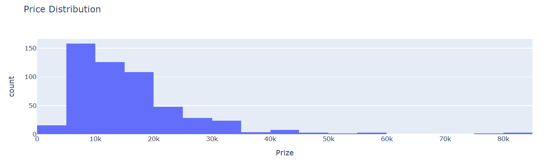
Univariate Analysis
This analysis shows that most mobile devices fall within the mid-price range segment.
A smaller number of devices belong to the high price premium category.
The overall distribution is slightly right skewed due to expensive devices.
This pattern helps in understanding how prices are spread across the market.

Slide 8
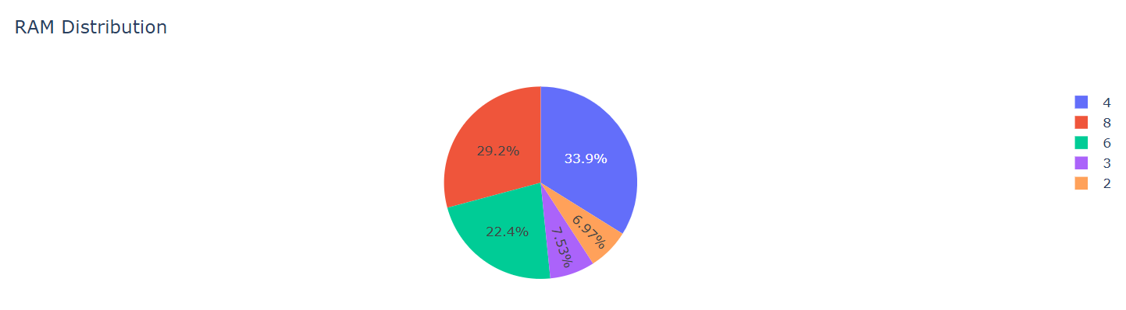
Univariate Analysis
The analysis shows that most mobile devices have RAM between 4gb & 8gb which is considered standard in the market.
This range provides a balance between performance & affordability for most users.
Devices with higher RAM are limited and usually fall under the premium category.
It also highlights how RAM plays an important role in device configuration.

Slide 9
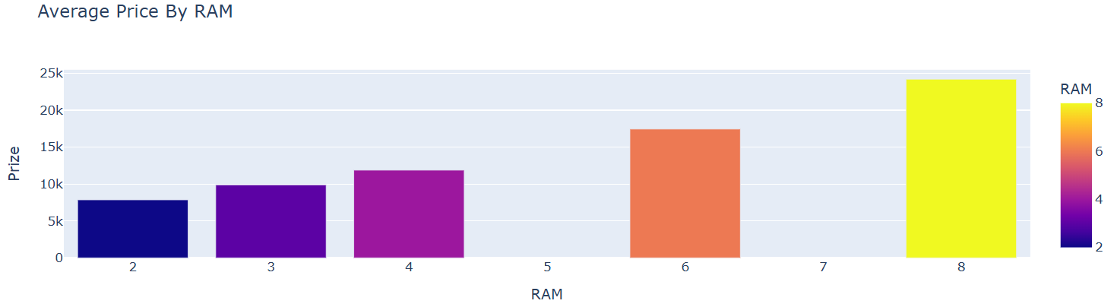
Bivariate Analysis
There is strong positive relationship between RAM capacity & mobile price in the dataset.
As RAM increases the average price of mobile devices also increase significantly.
RAM is considered one of the most important factors affecting mobile pricing.
This relationship helps in understanding feature-based pricing strategies.

Slide 10
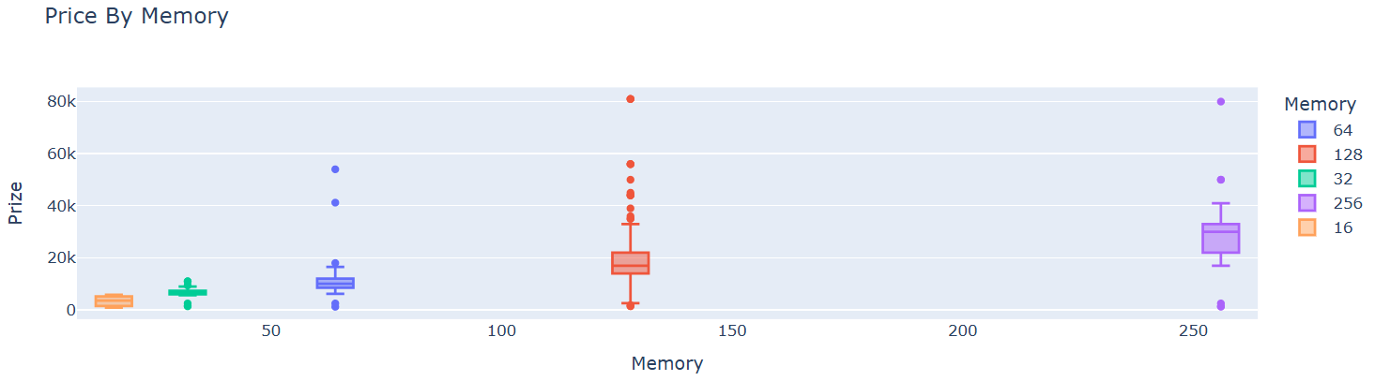
Bivariate Analysis
There is strong positive relationship between RAM capacity & mobile price in the dataset.
As RAM increases the average price of mobile devices also increase significantly.
RAM is considered one of the most important factors affecting mobile pricing.
This relationship helps in understanding feature-based pricing strategies.

Slide 11
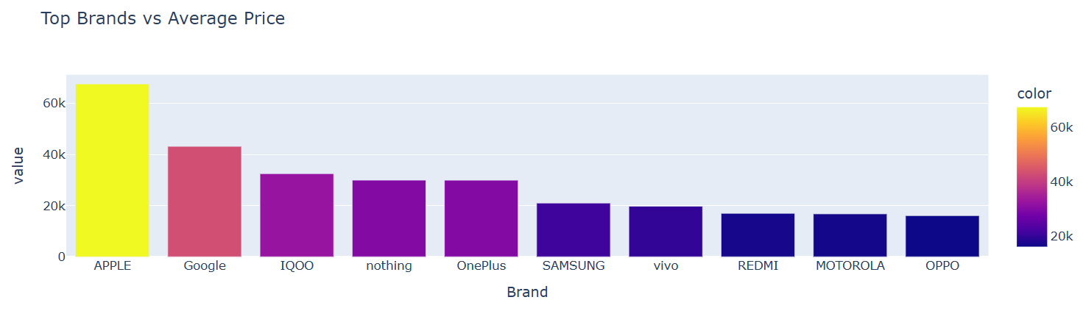
Bivariate Analysis
The chart compares different mobile brands based on their average pricing in the dataset.
It shows Apple & Google have the highest average prices representing the premium segment.
Brands like IQOO & nothing fall in the mid to premium range segment.
Other brands such as Samsung, Vivo, Redmi, Motorola and Oppo operate in lower to mid price ranges.

Slide 12
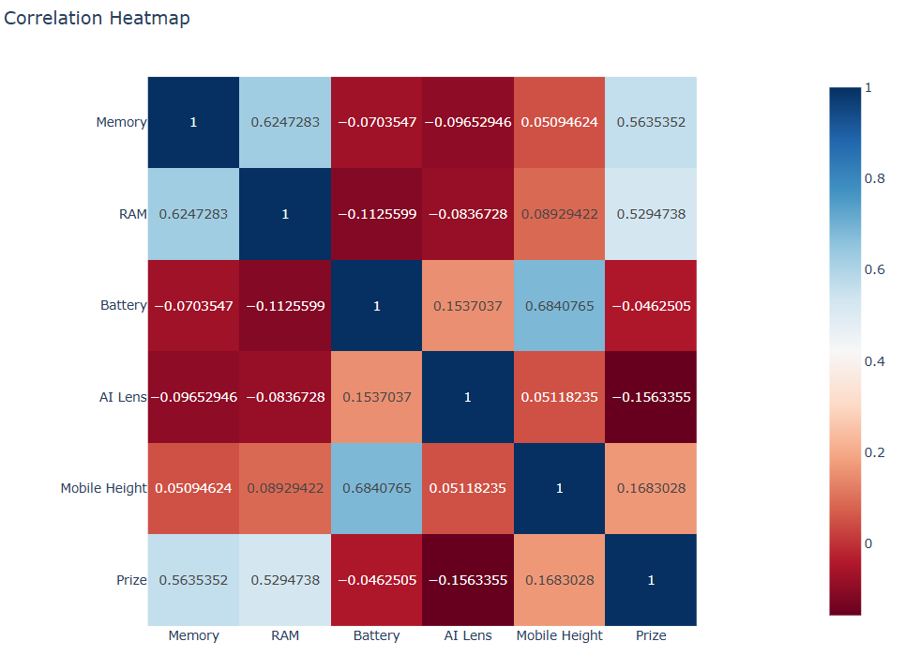
Multivariate Analysis
The heatmap shows the relationship between different numerical features in the dataset.
It clearly indicates that RAM has a strong positive correlation with mobile price.
Memory also shows a high correlation making it another important pricing factor.
Battery & other features have relatively weak correlation with price.
The chart helps in visually identifying the most impactful variables.

Slide 13
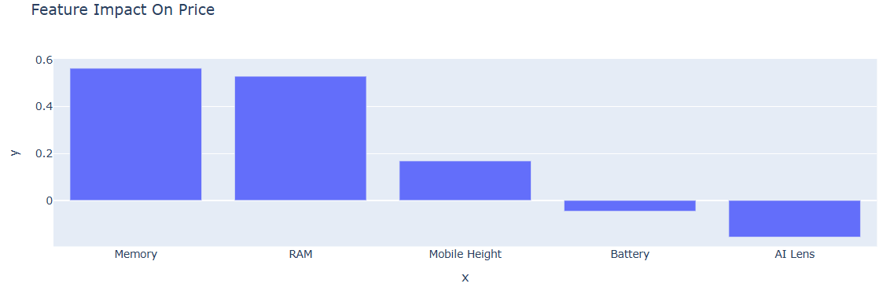
Multivariate Analysis
The chart shows the importance of different features in influencing mobile prices.
It clearly indicates that RAM has the highest impact on price among all variables.
Memory is the second most important feature showing strong influence on pricing.
Other features such as Battery, Height & AI lens have very low important values.
The chart helps in identifying which features should be prioritized.

Slide 14
Key Observations
The analysis shows that most mobile devices are concentrated in the mid-range price segment.
RAM & Memory were identified as the most influential features affecting pricing.
Outliers in the dataset mainly represent premium flagship devices with higher prices.
Battery capacity showed relatively low correlation and minimal impact on pricing.
The distribution patterns indicates higher demand for balanced performance devices.
These observations highlight important patterns in the dataset.

Slide 15
Business Insights
Companies should focus on RAM & Memory while designing mobile pricing strategies.
Mid-range segment offers the highest demand and strong competitive opportunities.
Premium devices target a niche but high value customer segment.
Feature based pricing can help in better product positioning.
Understanding customer preference can improve product development decision.
Balancing performance and affordability is key for market success.
These insights support more effective and data driven business strategies.

Slide 16
Conclusion
The project successfully analyzed mobile pricing using data analytics techniques.
It identified strong relationship between key features and mobile price.
RAM & Memory were found to be the most important pricing factors.
The analysis provided meaningful insights for business decision making.
The dataset helped in understanding pricing patterns.
The highlights the practical use of exploratory data analysis in real scenarios.
Overall, the project demonstrates the importance of data analysis in practical scenarios.

Slide 17
Reference Links Used For Learn
https://www.geeksforgeeks.org/data-analysis/exploratory-data-analysis-in-python/
https://www.ibm.com/think/topics/data-cleaning
https://plotly.com/python/bar-charts/
https://plotly.com/python/box-plots/
https://plotly.com/python/heatmaps/

Slide 18
Thank You

